Slide 1


Geo Flood Agent
Natural language → GIS code → isolated execution → cascade analysis
Solafune | Daytona HackSprint Tokyo | 12 September 2026

Slide 2
The problem: what hurts is the facility that is NOT under water but stops
Hazard maps only tell you where the water goes.
A hospital on high ground still goes dark if its substation sits in the lowlands.
That cascade never shows up in raster analysis — you have to walk the relationships.
Cascade example
Ueno Plateau Hospital
elevation 19 m · not flooded
↓ POWERED_BY ↓
"If the lower Arakawa rises 3 m, which facilities are affected?"
Kita-Senju Substation
One question triggers GIS code generation → isolated execution → graph cascade analysis → briefing,
returned in a form a municipal emergency operations center can act on.
elevation −0.4 m · 3.4 m under water
→ hospital loses power while staying dry

Slide 3
Architecture: one role per platform that would not work without it
NOSANA
DAYTONA
NEO4J
LLM inference (decentralized GPU)
Isolated sandbox
Knowledge graph
• Writes the GIS script from the question
• OpenAI-compatible endpoint, one-line swap
• Turns results into an EOC briefing
• Safely runs arbitrary LLM-written code
• Fetches GSI elevation tiles → flood mask → map PNG
• create → upload → exec → download → delete
• Facilities and power feeds as a graph
• Writes each scenario as FLOODED_IN edges
• 2-hop Cypher finds outages outside the water
→
→
Question → [Nosana] code → [Neo4j] facilities → [Daytona] execute → [Neo4j] cascade query → [Nosana] briefing
Every call is flag-switchable; a platform that is down falls back to a same-interface mock, labelled MOCK in the UI

Slide 4
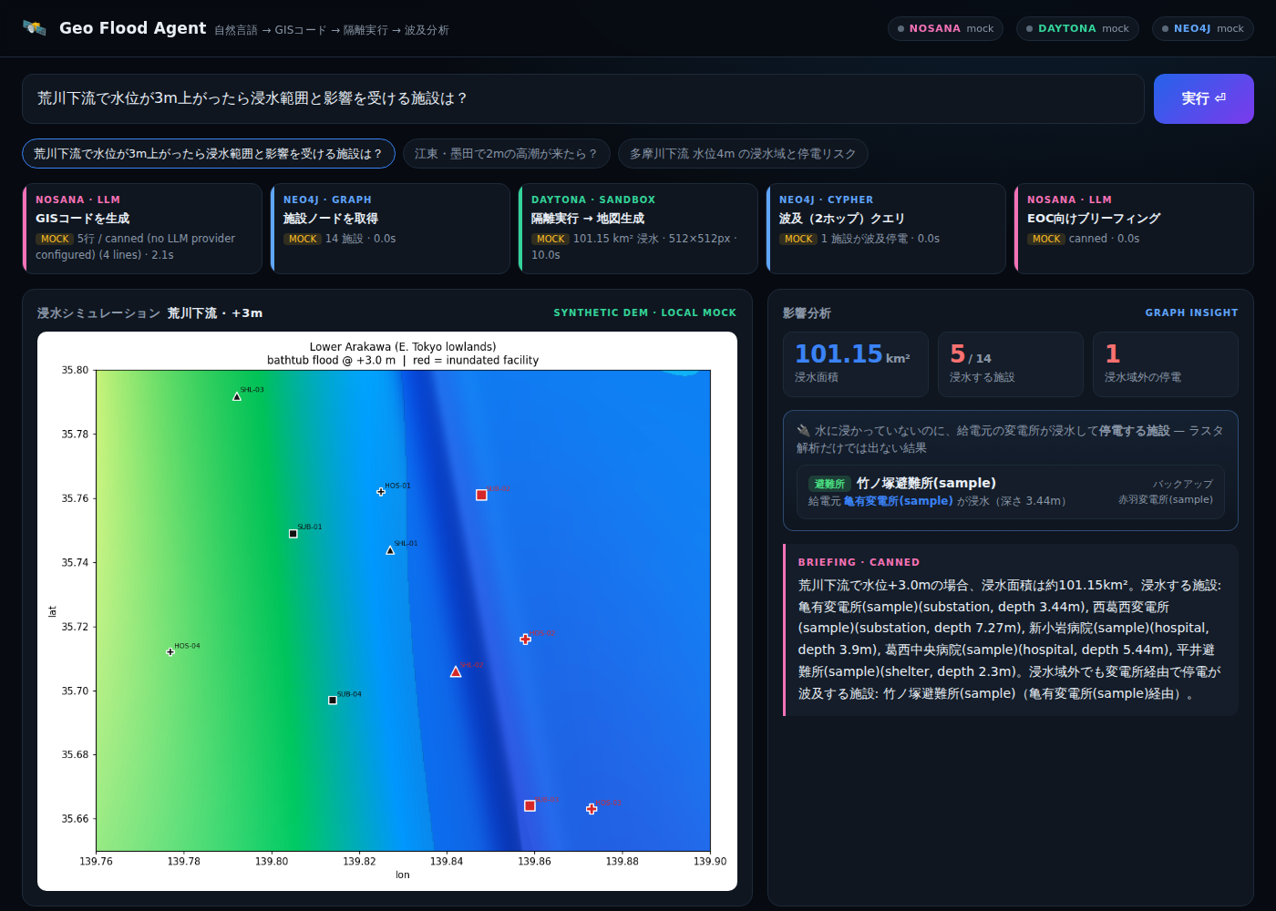
Demo: one question → flood map and the power cascade
101 km²
flooded area (+3.0 m, lower Arakawa)
5 / 14
facilities under water
1
facility losing power outside the water
Each pipeline stage shows LIVE or MOCK. Generated code, Cypher and the live log are all exposed in the UI.

Slide 5
Where we are, and what comes next
Honest status today
Next
• Neo4j Aura: live — scenario writes and the 2-hop cascade query
• Daytona: sign-up from the venue was blocked by anomaly detection for our whole team (confirmed with support). The same script runs through the local fallback; the integration is 30 lines in agent/sandbox.py and goes live by pasting an API key
• Nosana: OpenAI-compatible client implemented; no endpoint yet, so a canned script stands in
• Elevation is real GSI tile data; facilities and power feeds are sample data
• Run SAR flood segmentation on Nosana GPUs and replace the bathtub model with observations
• Daytona snapshots for 1-second starts; evaluate water levels 1–5 m as N parallel sandboxes
• Load real municipal infrastructure (grid, shelters) into Neo4j and operate it in the EOC
• github.com/0xtkey256/geoflood

